Slide 1

Welcome To ‘Doctor's Finder’ (Web Project)

Slide 2
Presented By Md. Faysal Rabbi ID: 171-35-1833 Daffodil International University
Supervised By Mr. Md. Mushfiqur Rahman
Lecturer Daffodil International University

Slide 3
Problem statement:
When people are new in town, they don't have any idea about local medical facilities and doctors.
The hassle of arranging an appointment with unknown medical specialist
In addition getting directions to the place and dealing with insurance bureaucracy

Slide 4
Features:
D.C and Patient need to register except representative.
D.C and Admin can create/update/delete posts for patients.
Patients can view post which is created by D.C and Admin
Patients can create/update/delete post for his/her need.
Representative users can only view the posts.
Representative users don’t have the access to search by location.
All the users have access on FAQ option.
The system will also provide the area guide.
The whole system will be maintained by Admin.

Slide 5
Stakeholders:
D.C
Admin
Patient
Representative

Slide 6
Use case Diagram :

Slide 7
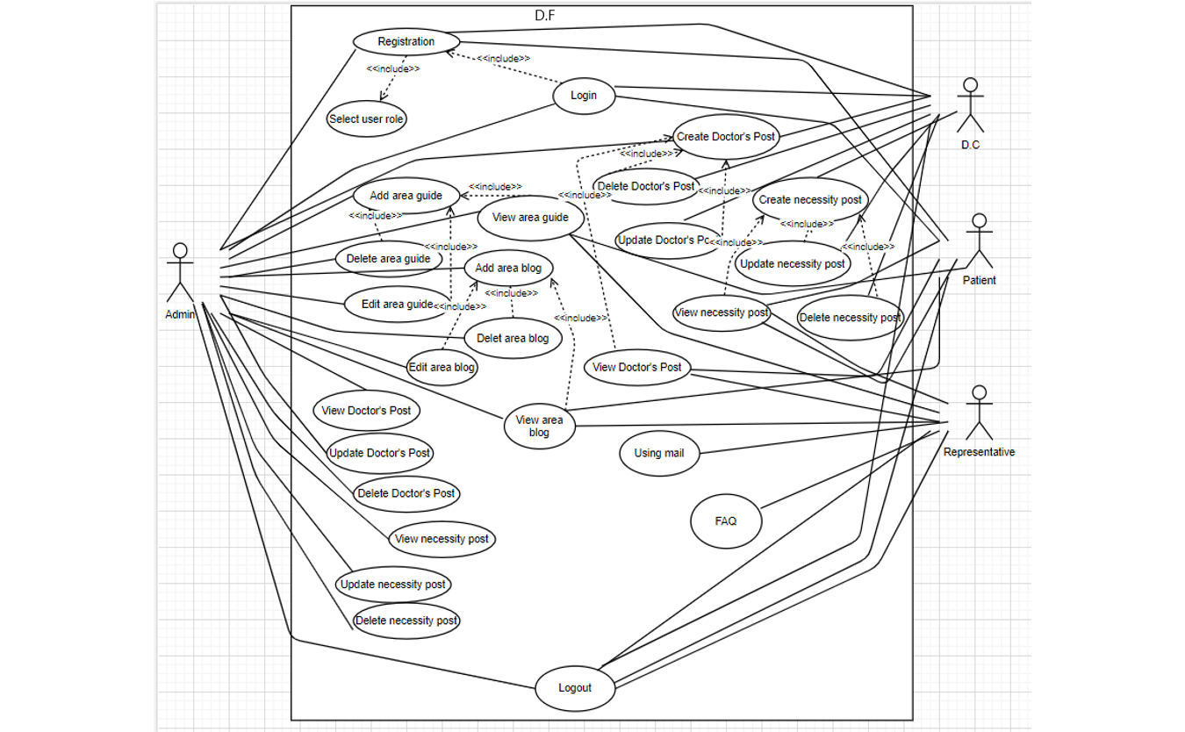
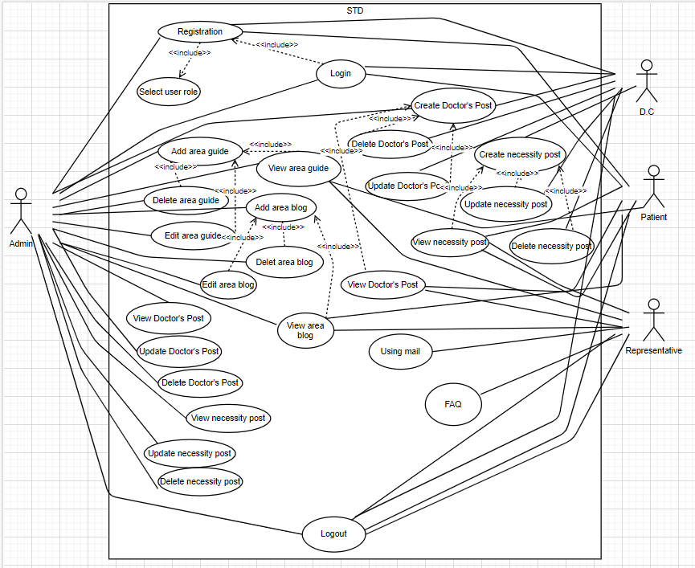

Slide 8
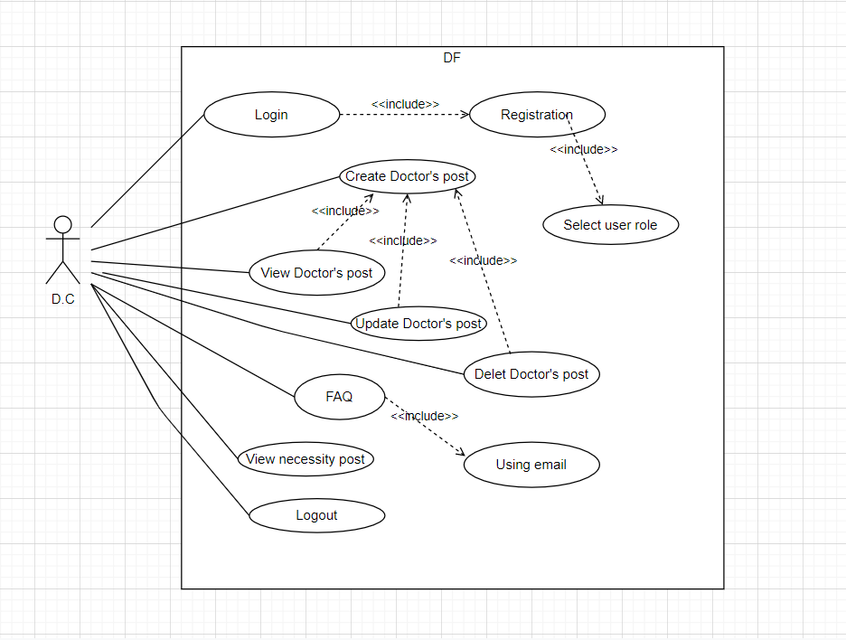
Use Case Diagram for D.C(Diagnostic Center)

Slide 9
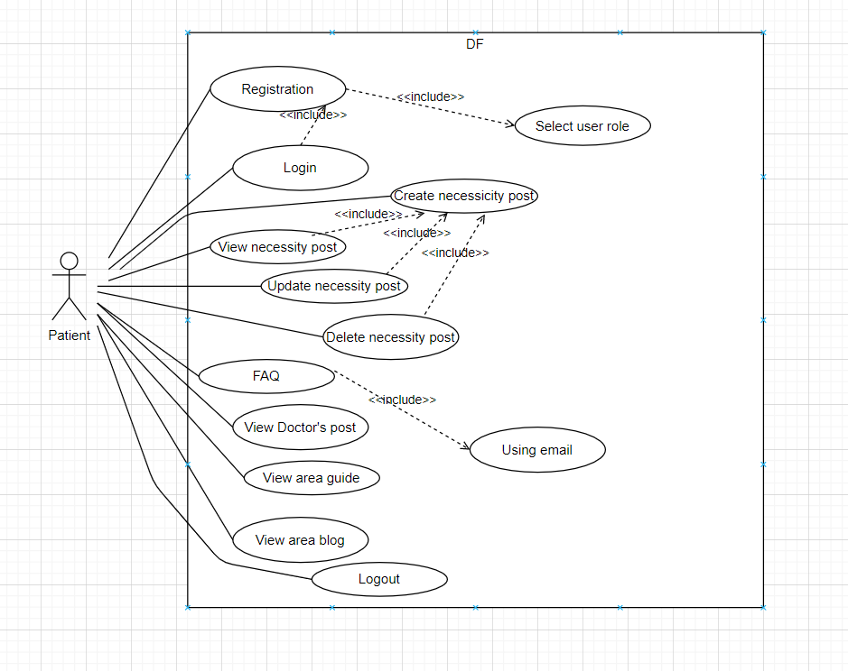
Use Case Diagram for Patient

Slide 10
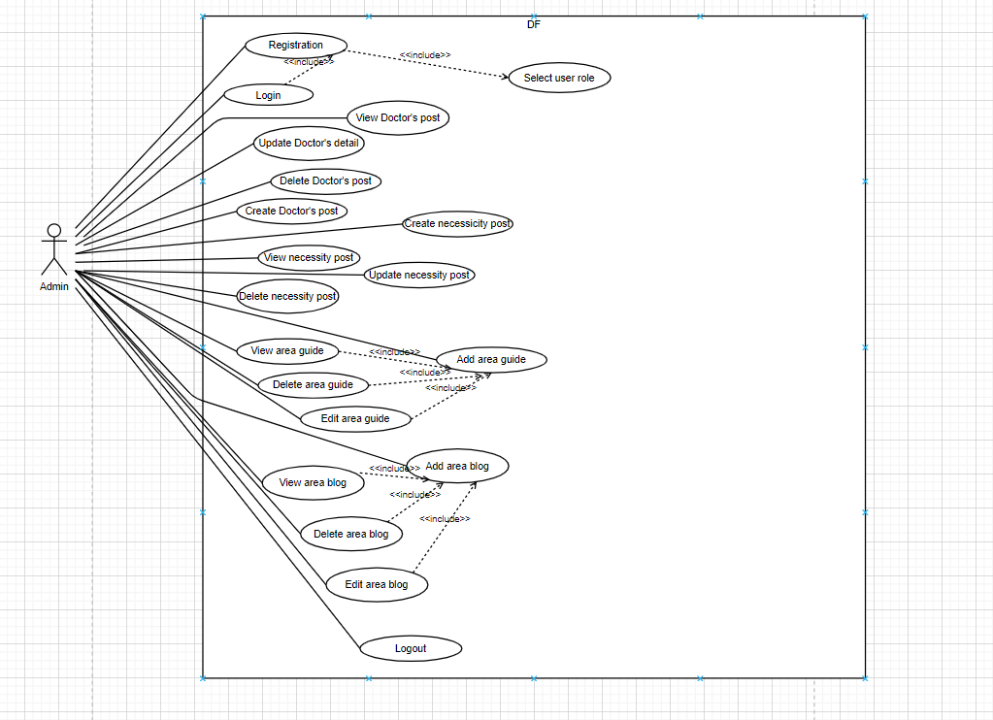
Use Case Diagram for Admin

Slide 11
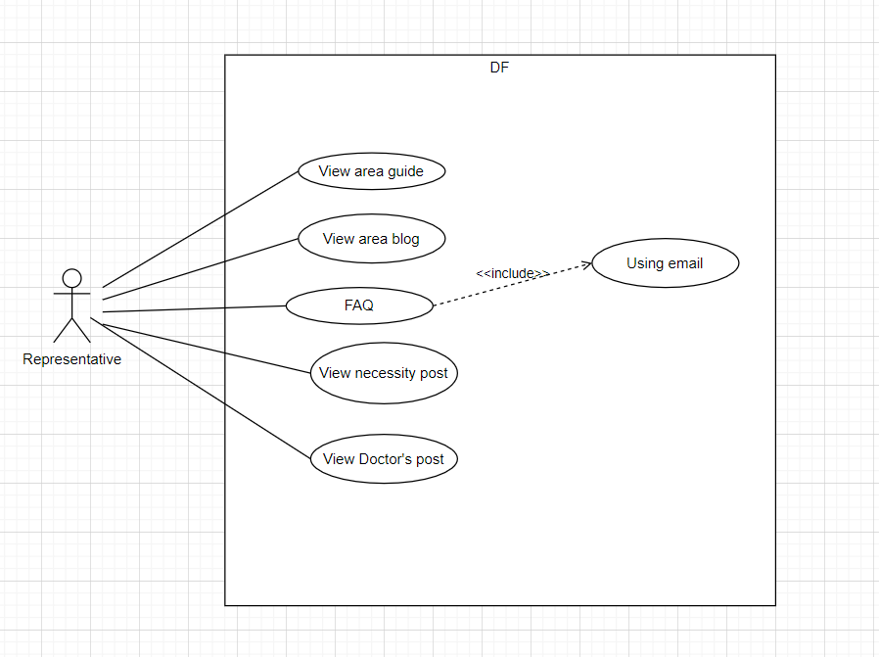
Use Case diagram for Representative

Slide 12
Activity Diagram :

Slide 13
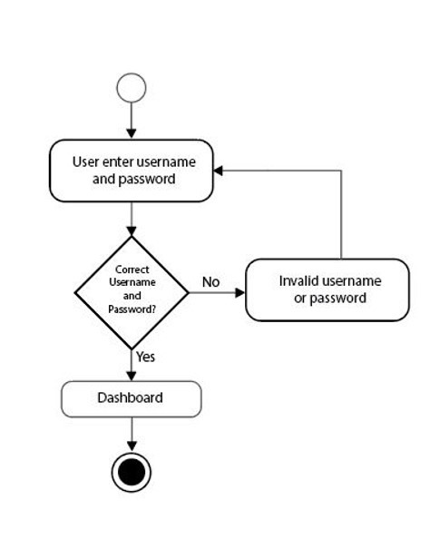
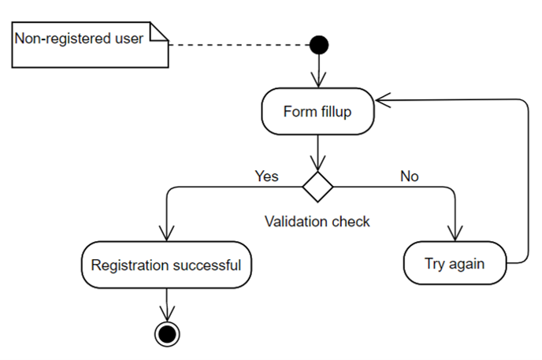
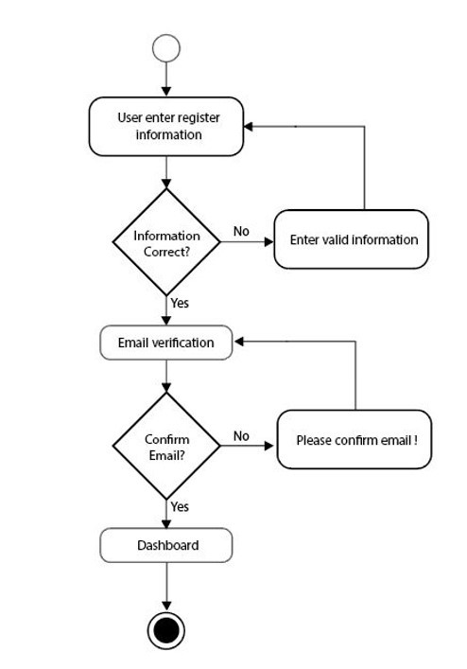
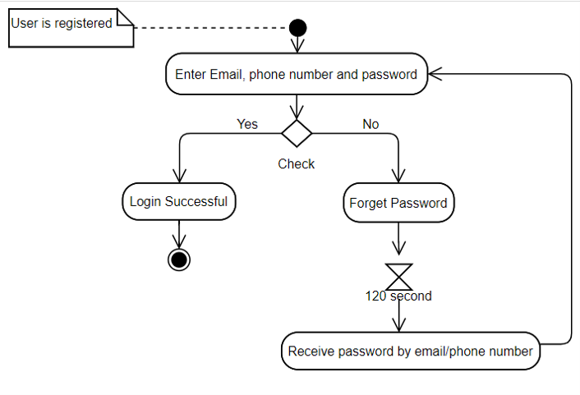
Registration
Login

Slide 14
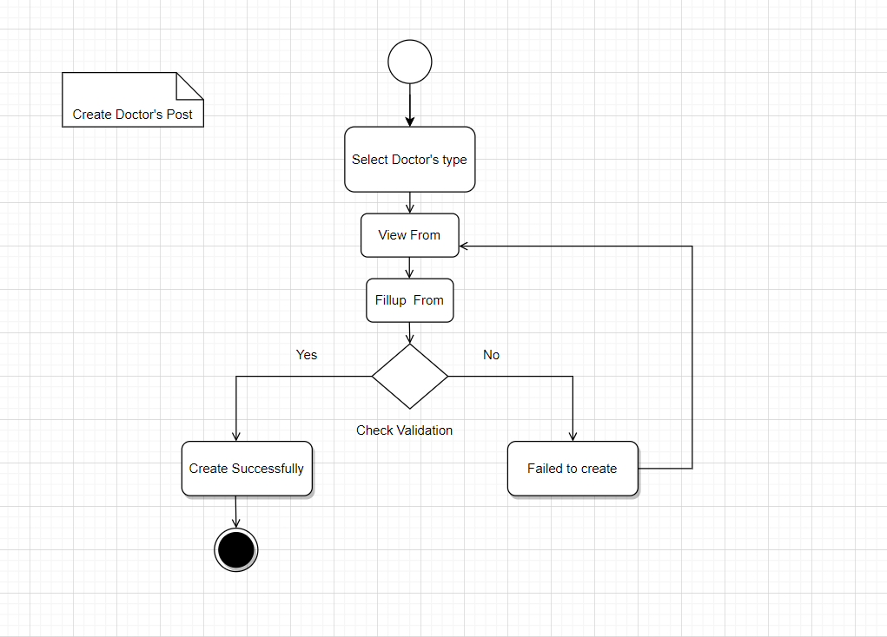
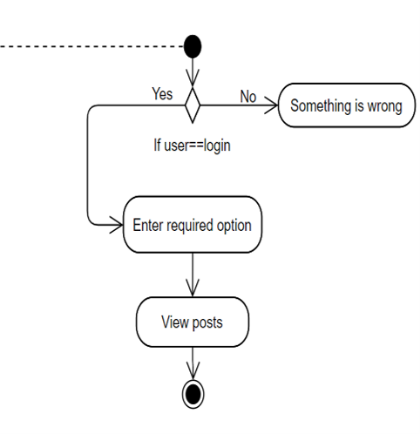
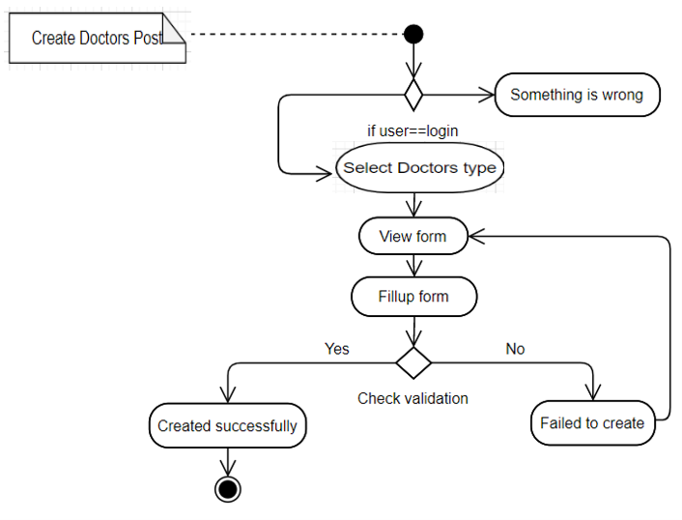
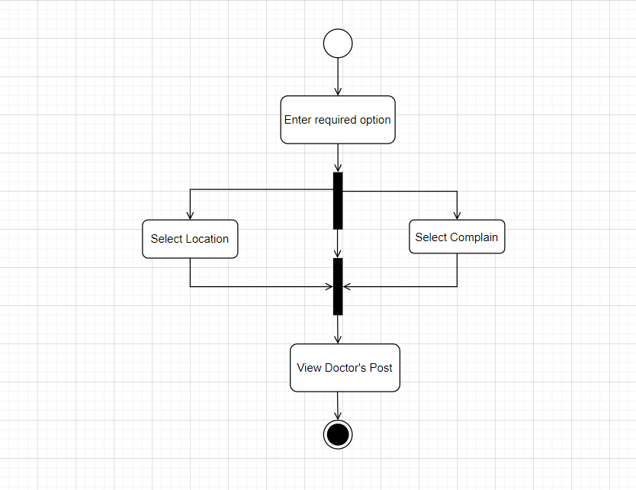
Create Doctor posts
View Doctor post

Slide 15
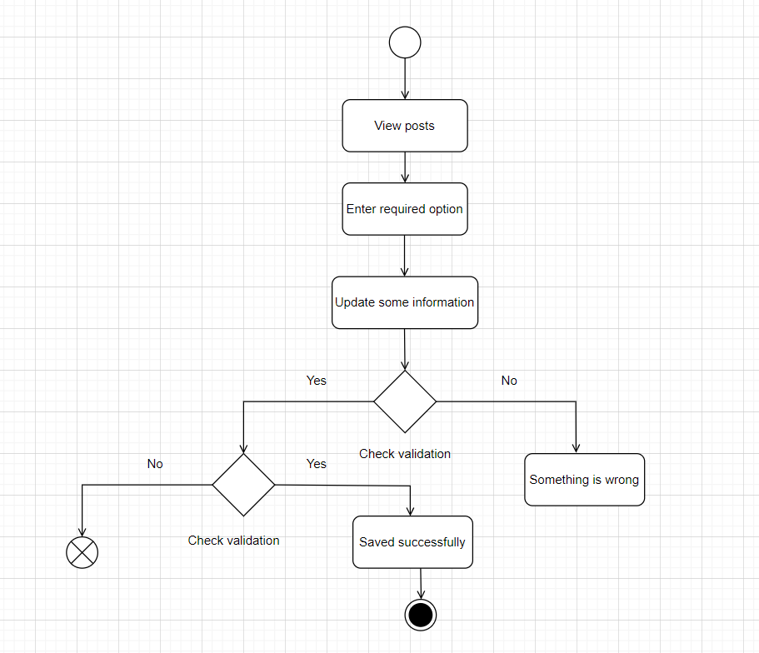
Update Doctor post

Slide 16
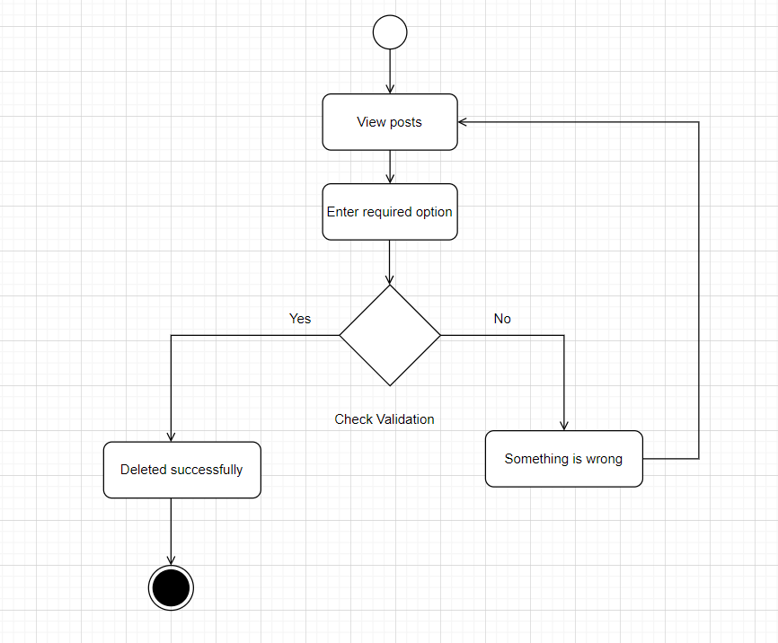
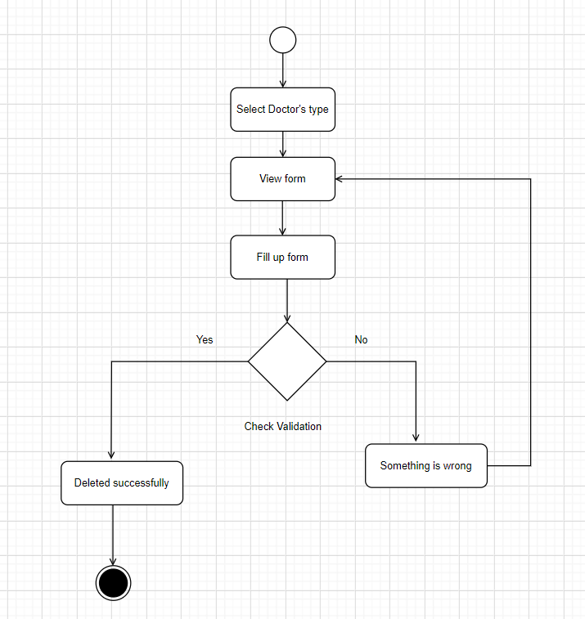
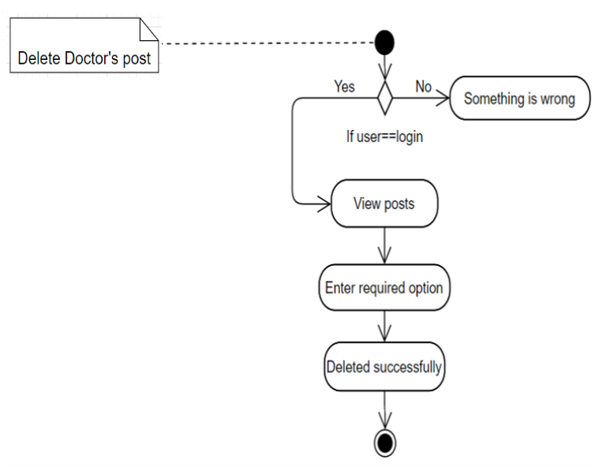
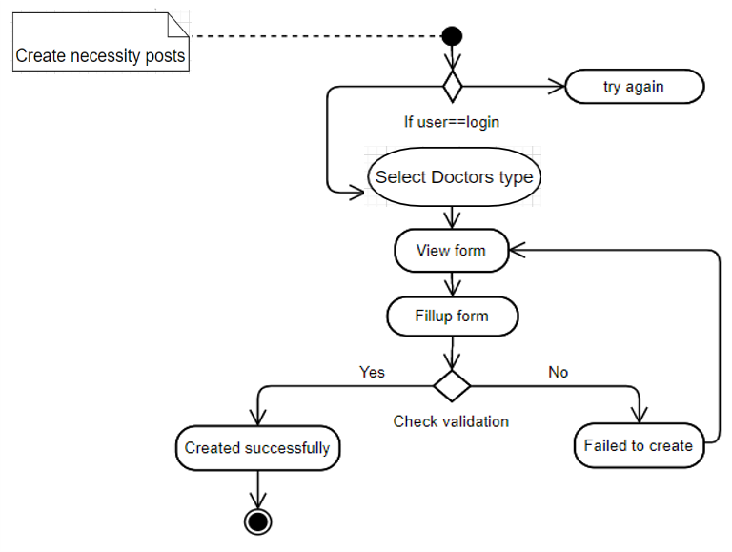
Delete Doctor post
Create necessity post

Slide 17
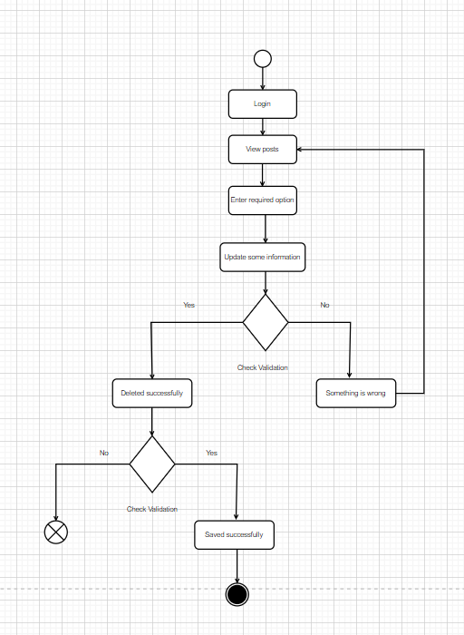
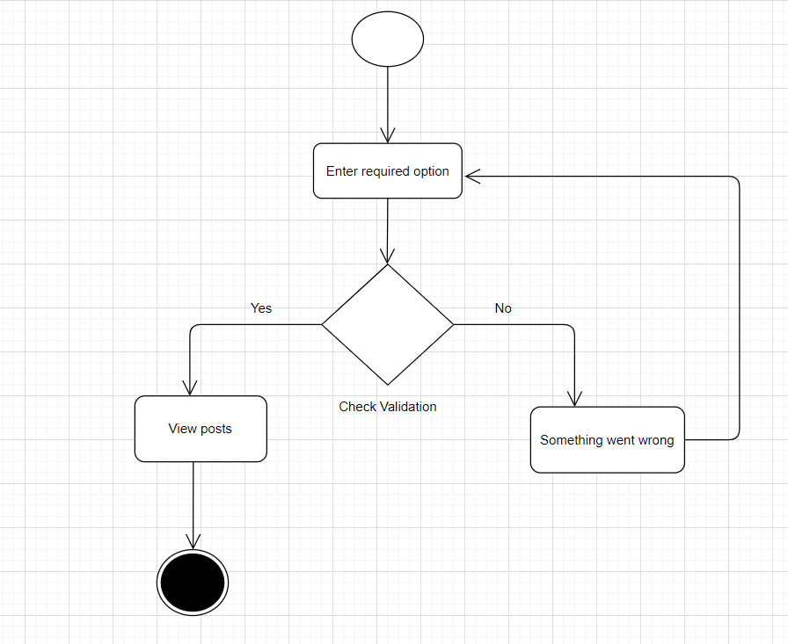
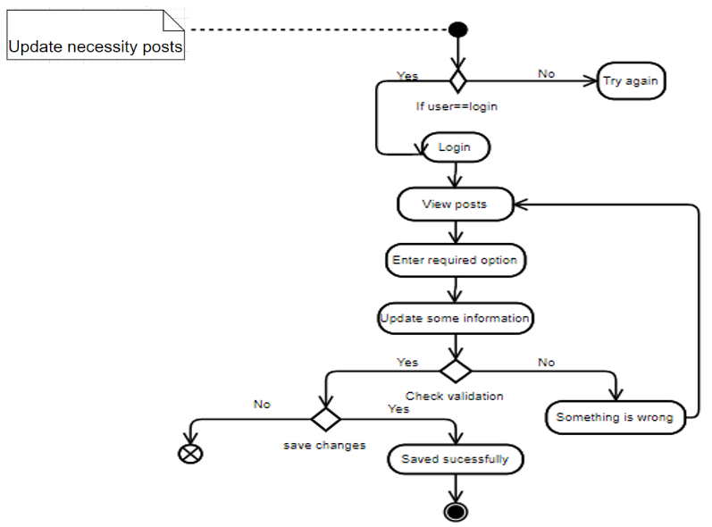
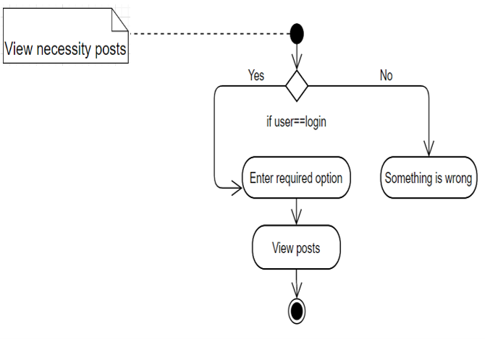
Update necessity post
View necessity posts

Slide 18
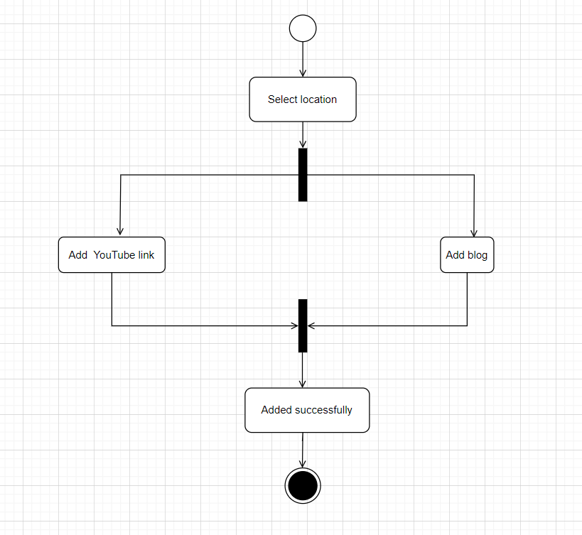
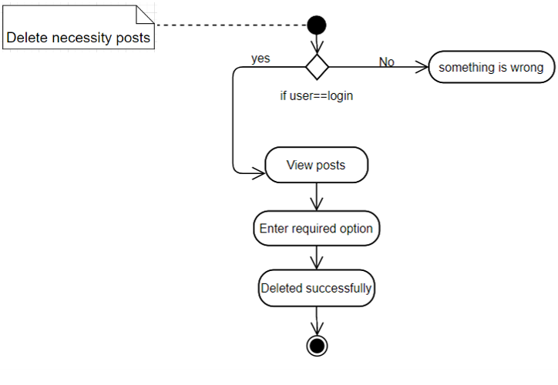
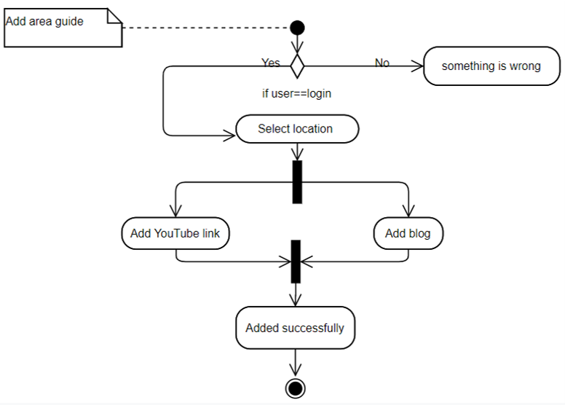
Delete necessity posts
Add area guide

Slide 19
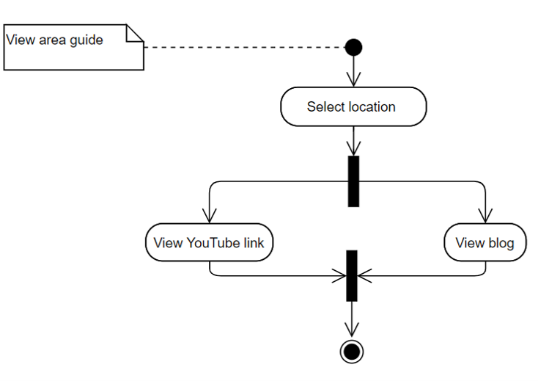
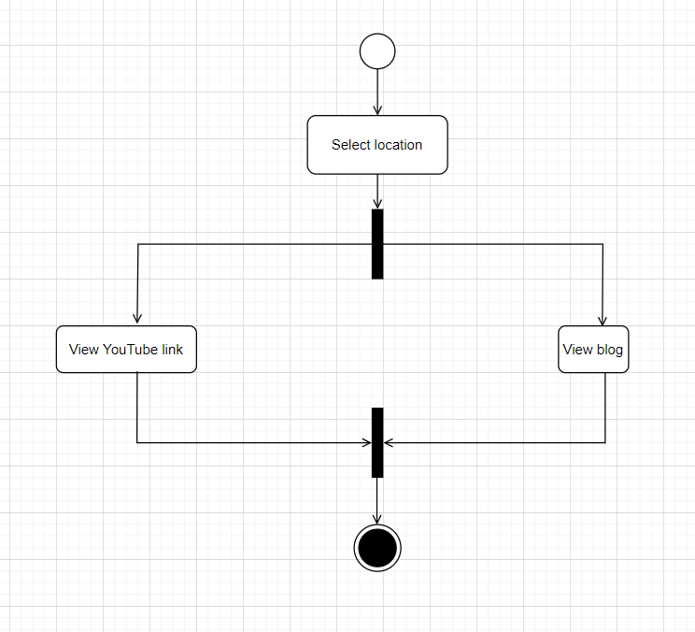
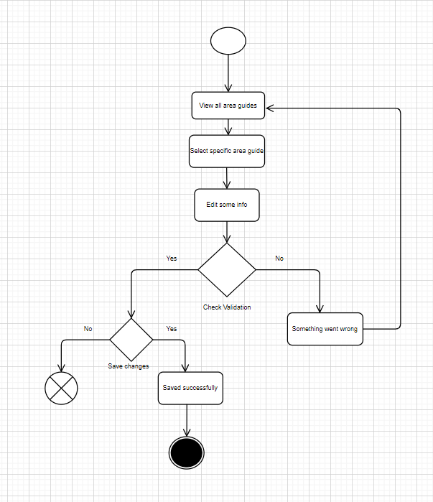
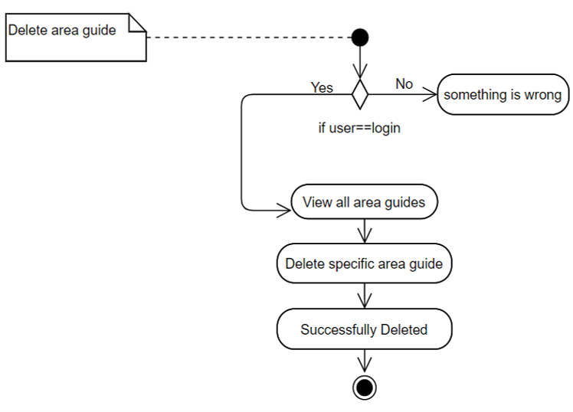
View area guide
Edit area guide

Slide 20
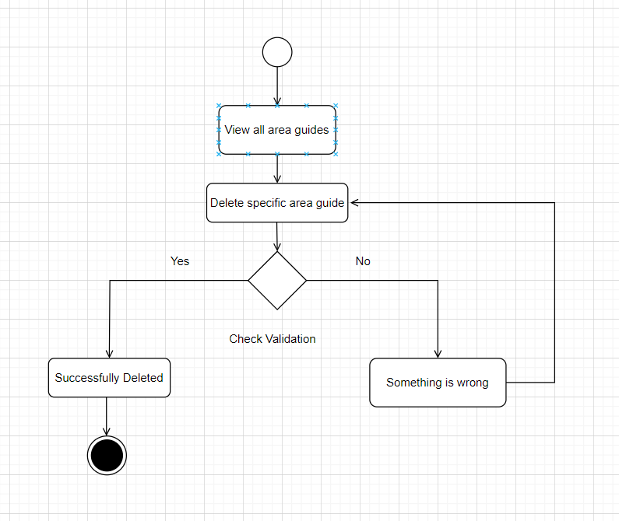
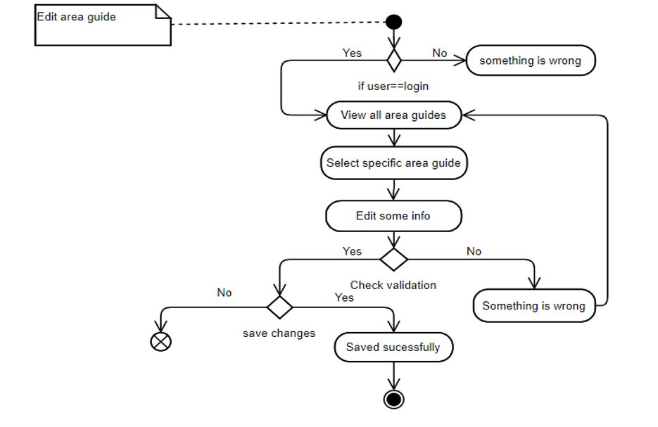
Delete area guide

Slide 21
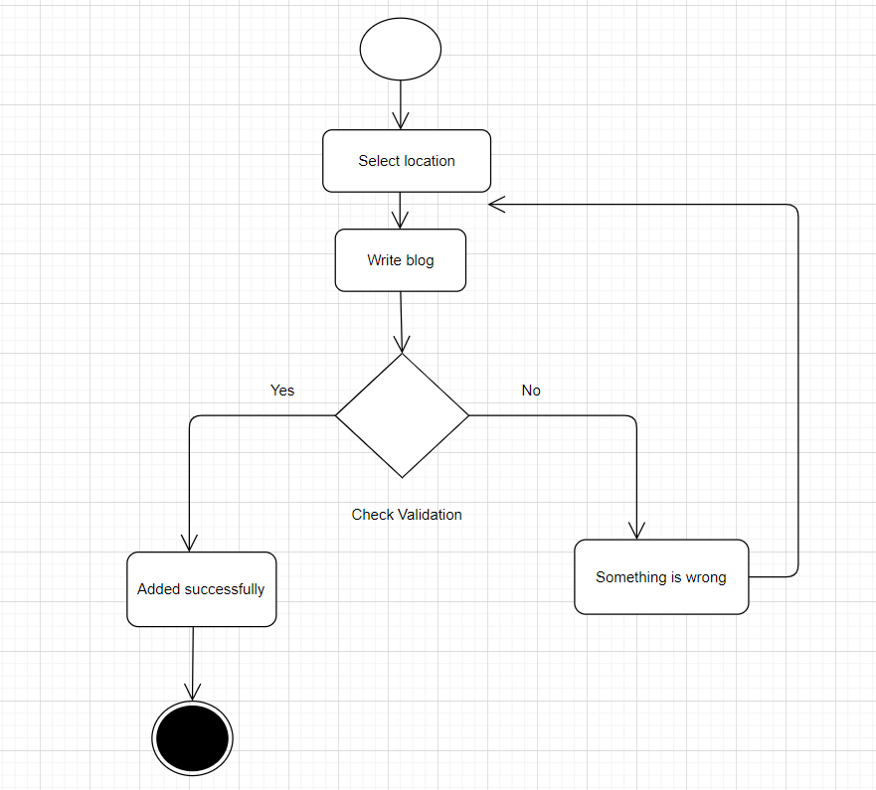
Add Area Blog

Slide 22
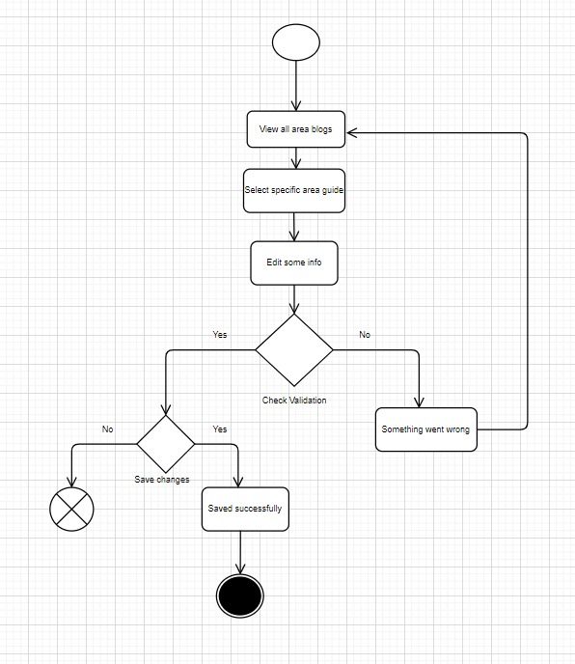
Edit Area Blog

Slide 23
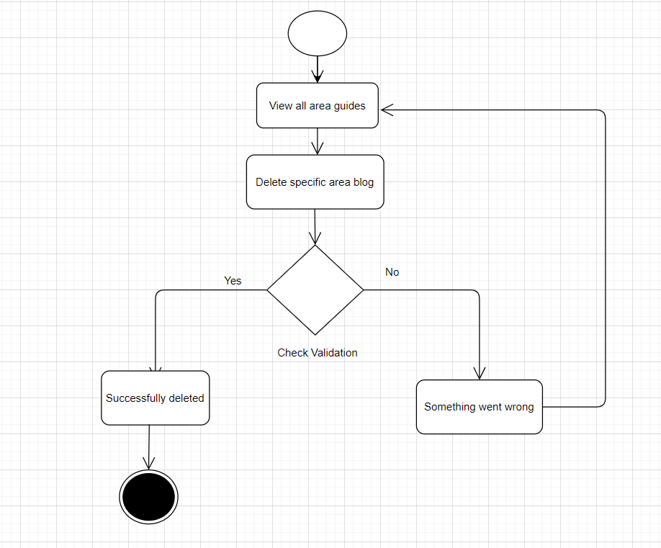
Delete Area Blog

Slide 24
Sequence Diagram :

Slide 25
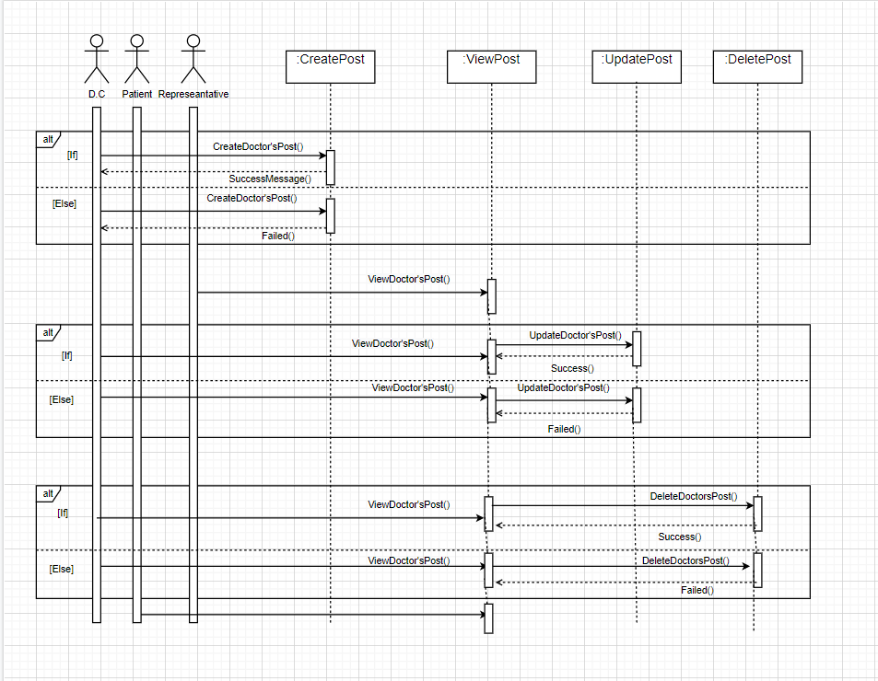
Doctor’s Issue for D.C, Patient and Representative

Slide 26
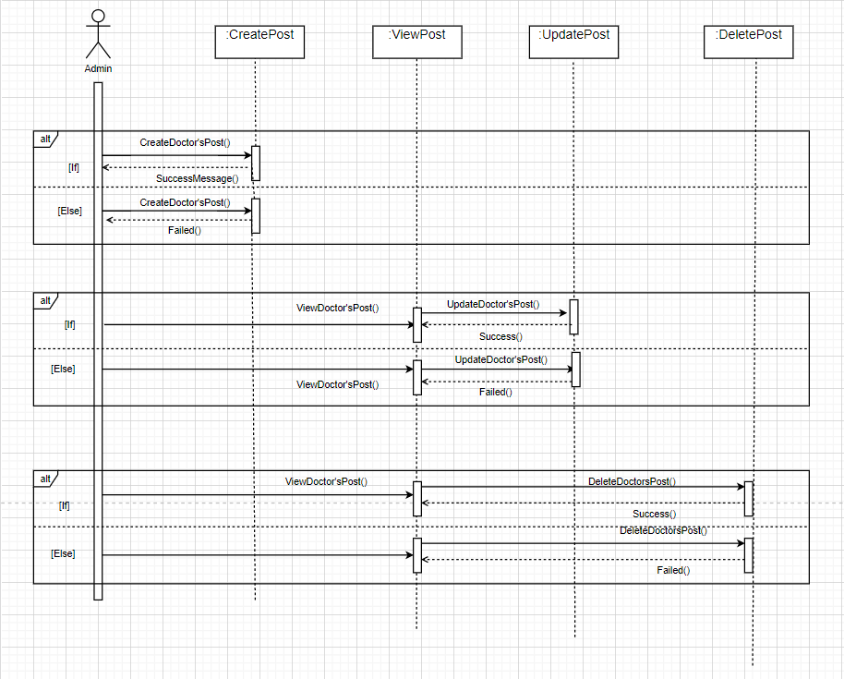
Doctor’s Issue for Admin

Slide 27
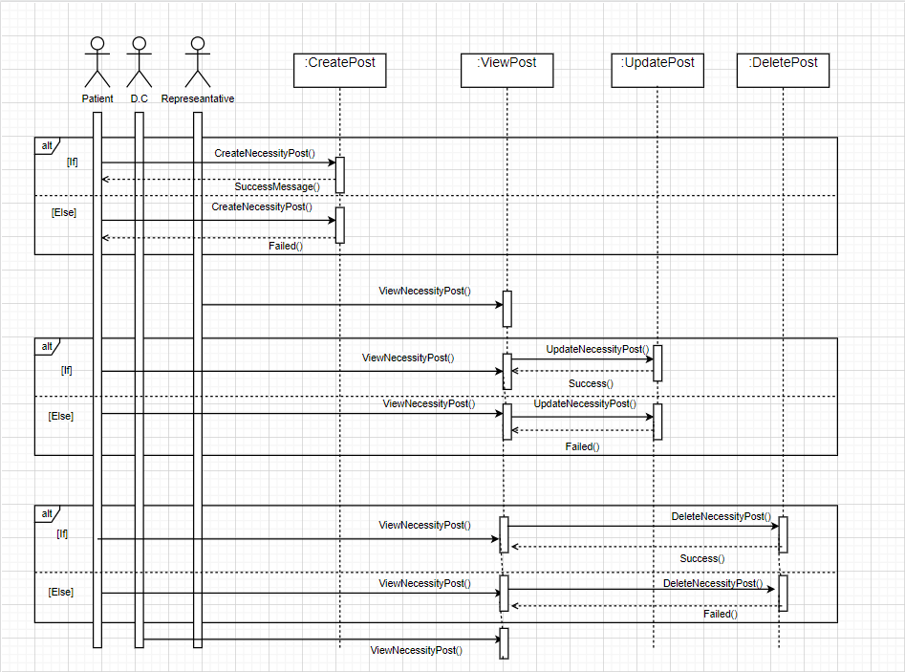
Necessity Issue for Patient, D.C and Representative

Slide 28
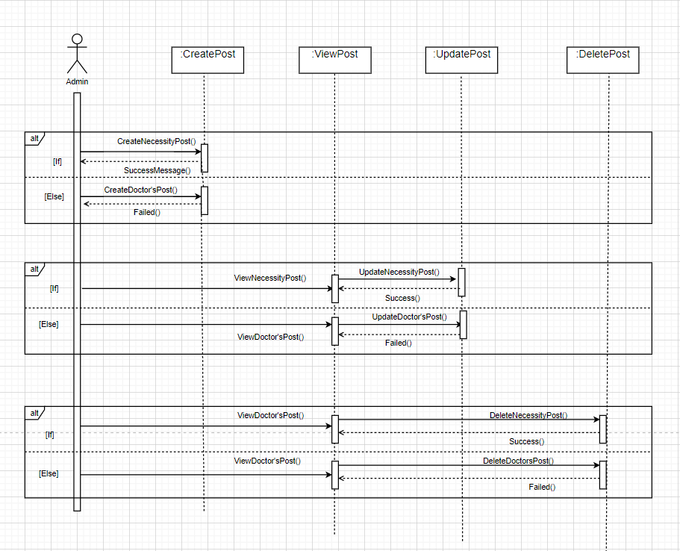
Doctor’s Issue for Admin

Slide 29
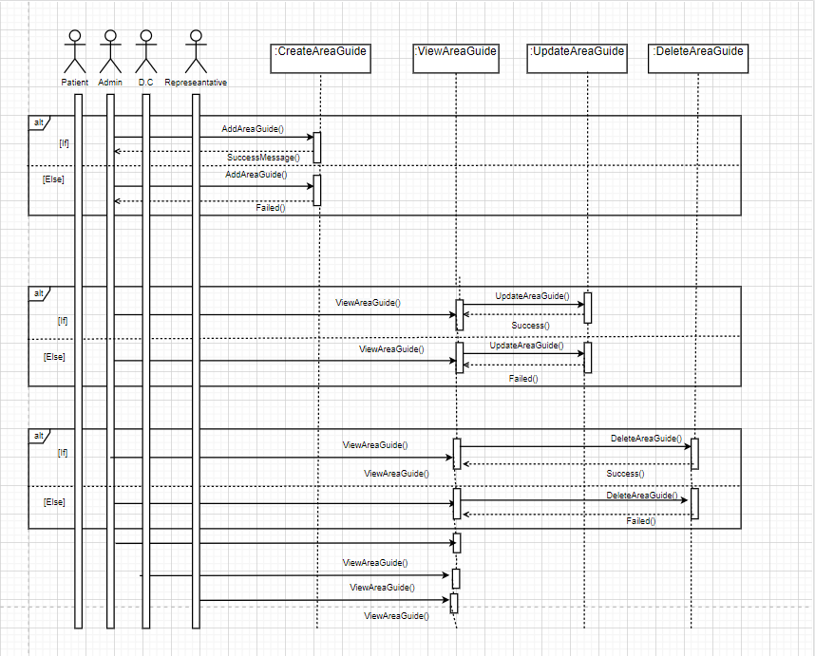
Area Guide Issue

Slide 30
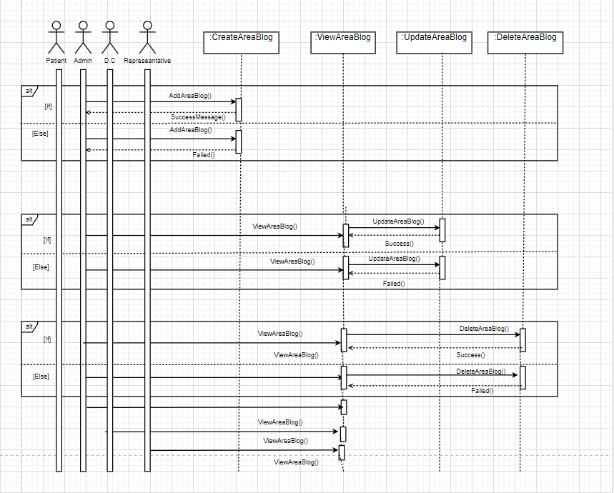
Area Blog Issue

Slide 31
Entity Relationship Diagram:

Slide 32
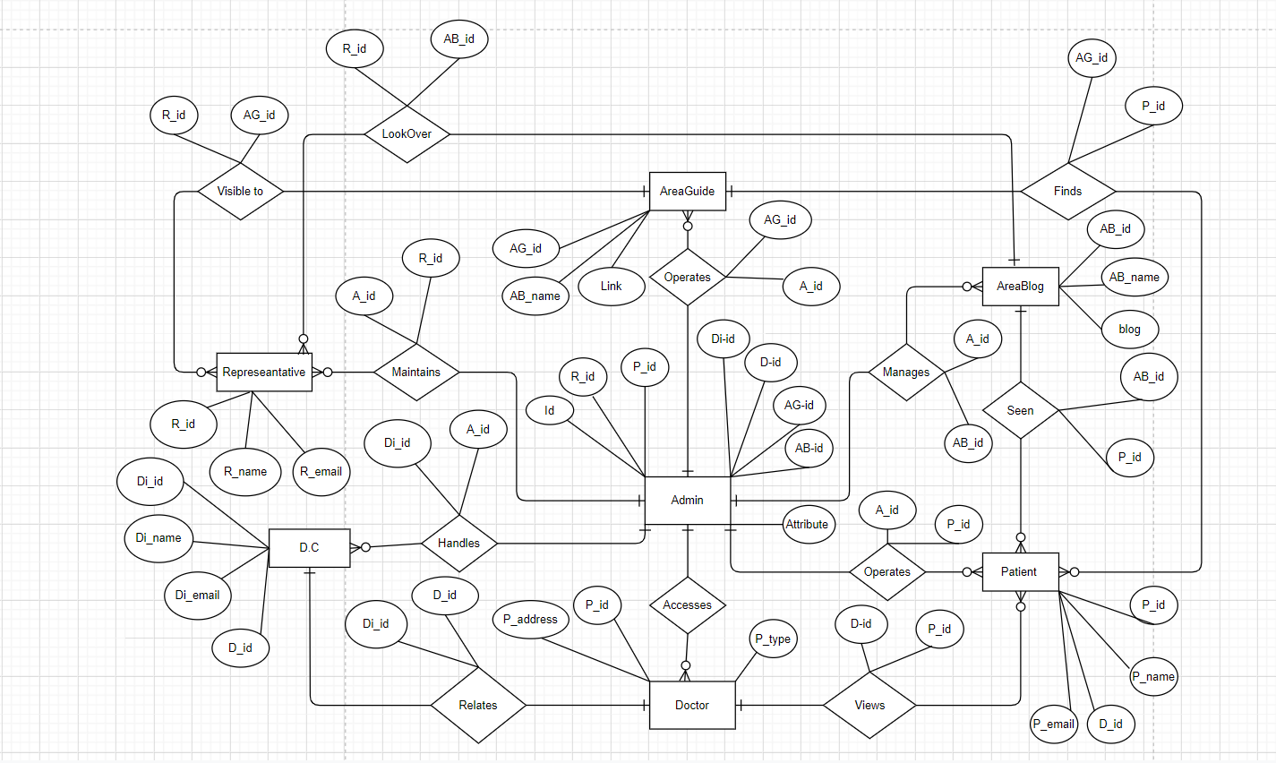

Slide 33
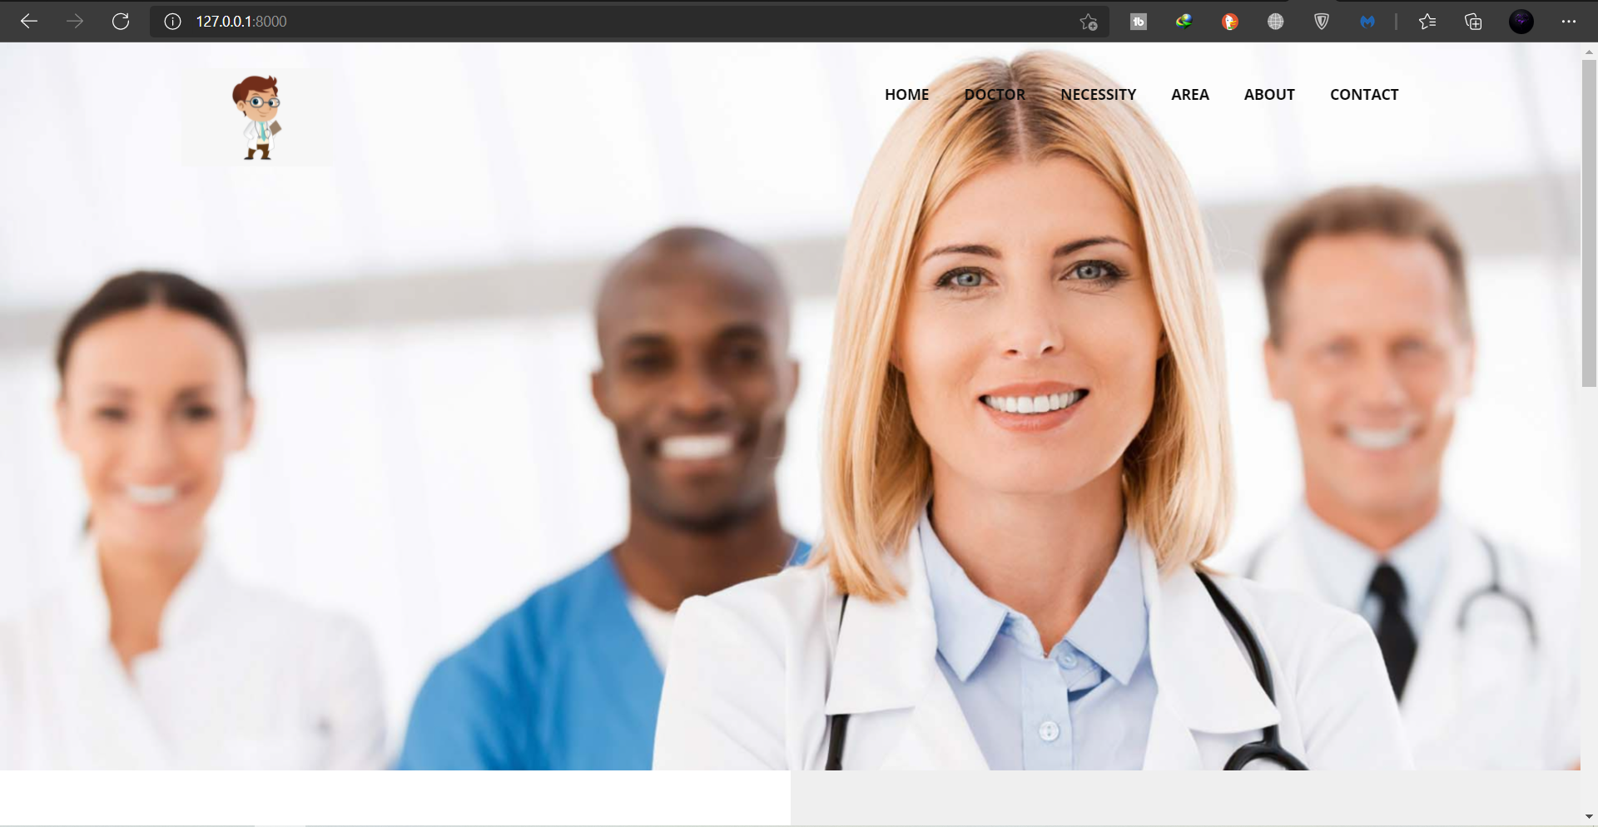
Home Page

Slide 34
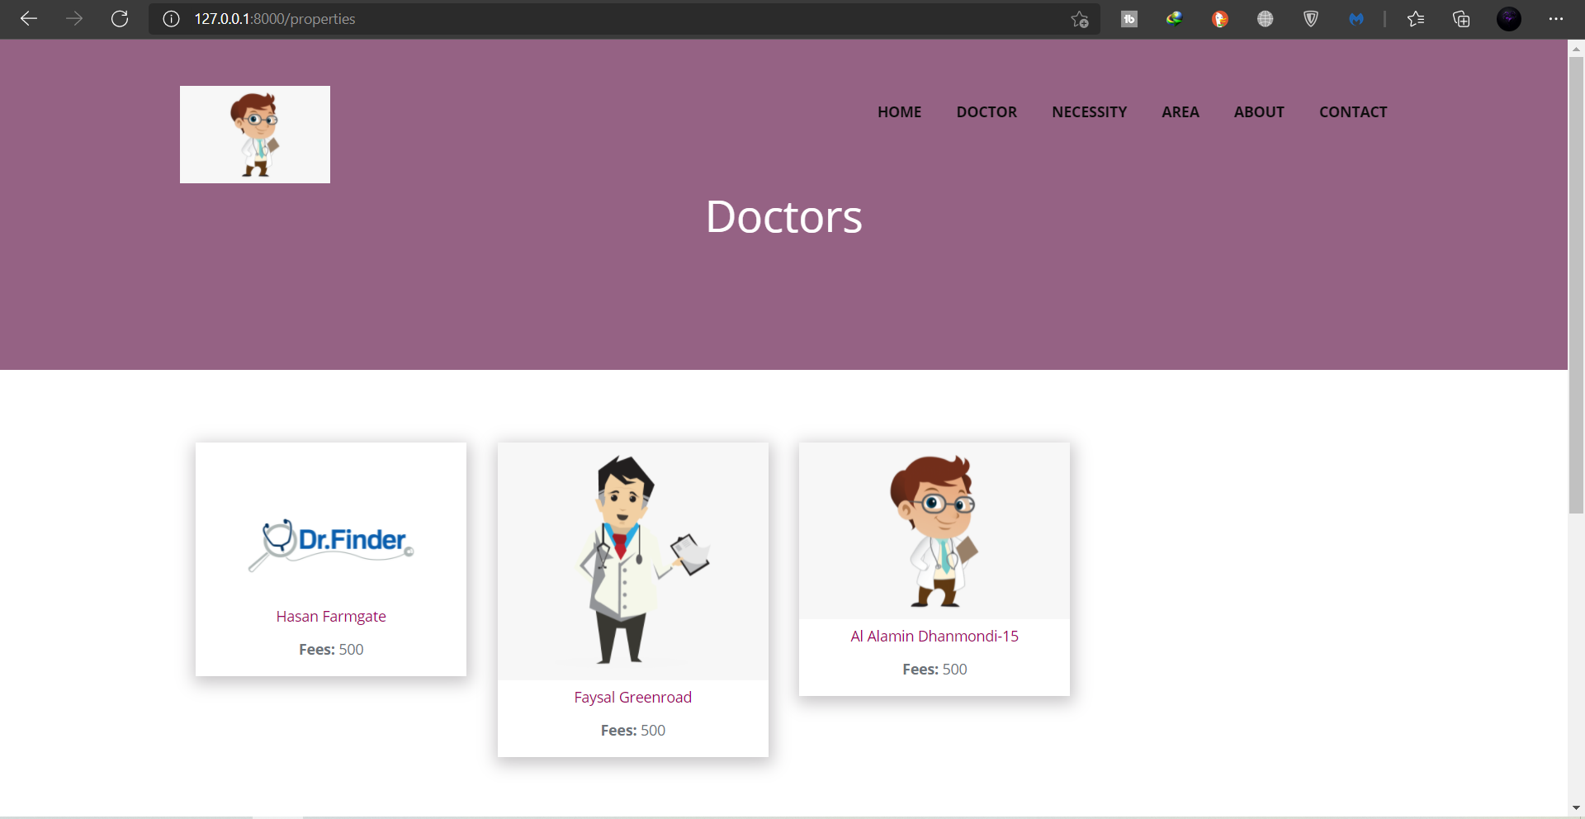
Doctor for Representative

Slide 35
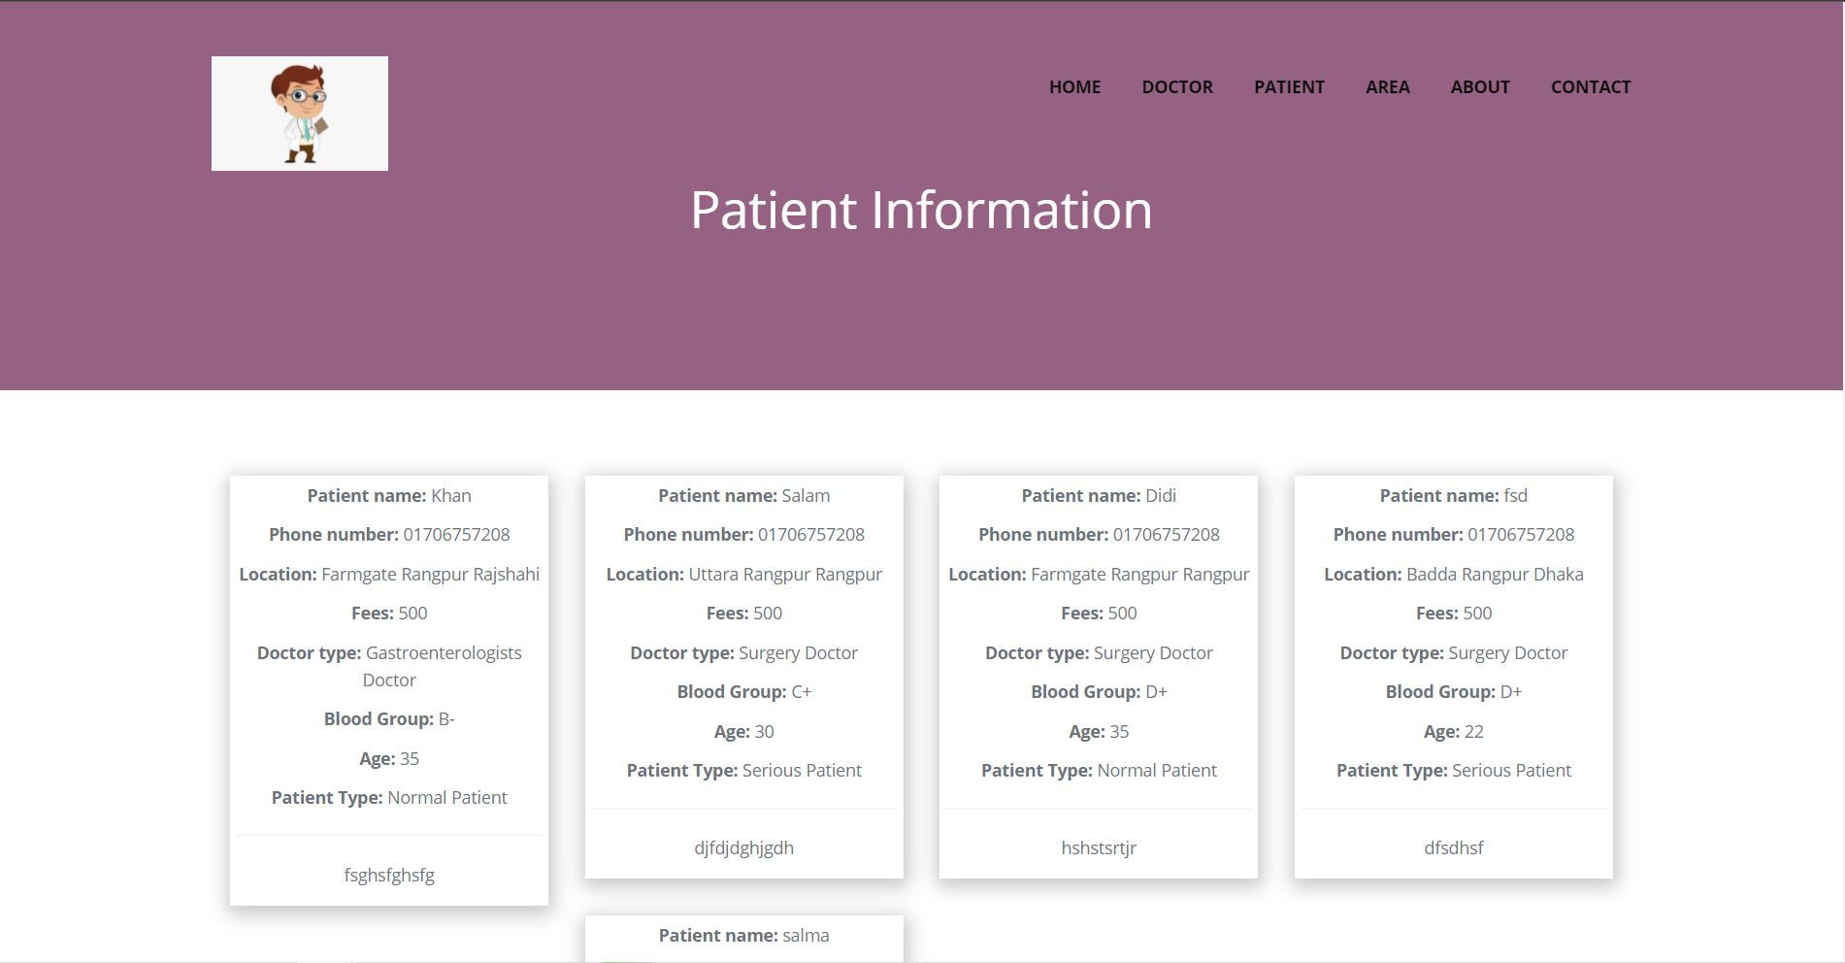
Patient for Representative

Slide 36
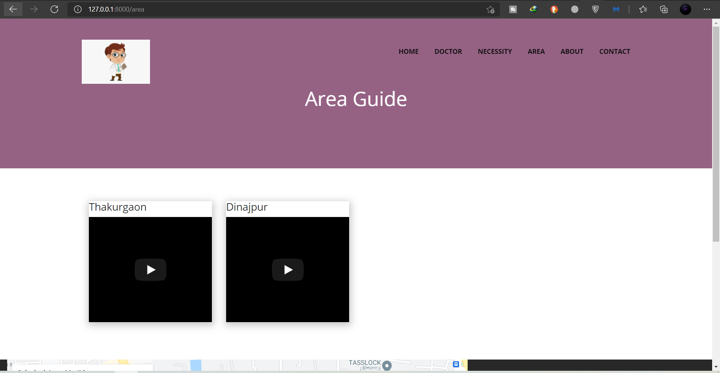
Area Guide

Slide 37
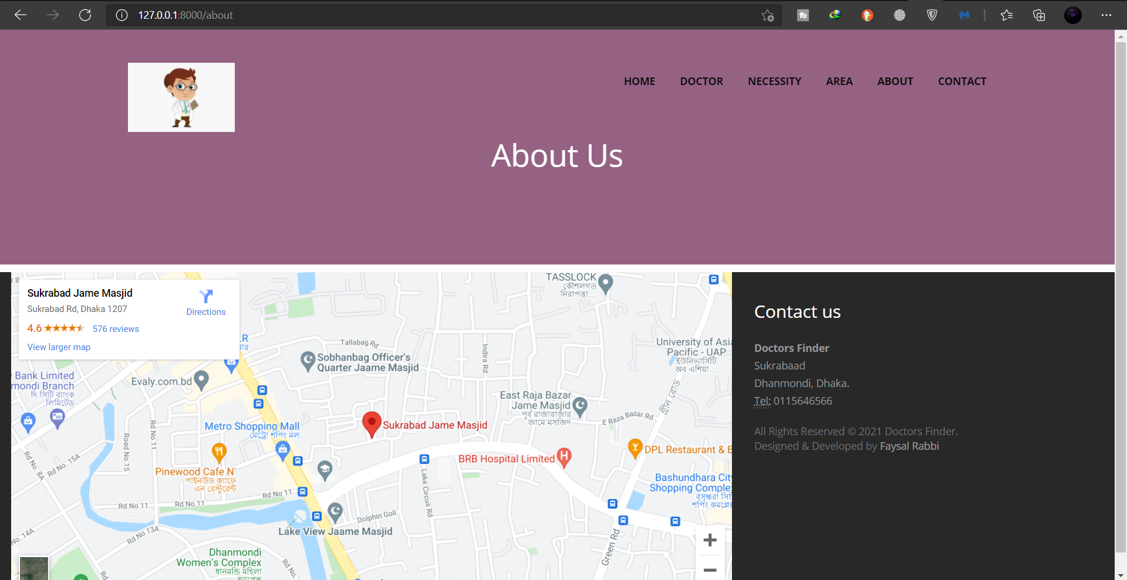
About Us

Slide 38
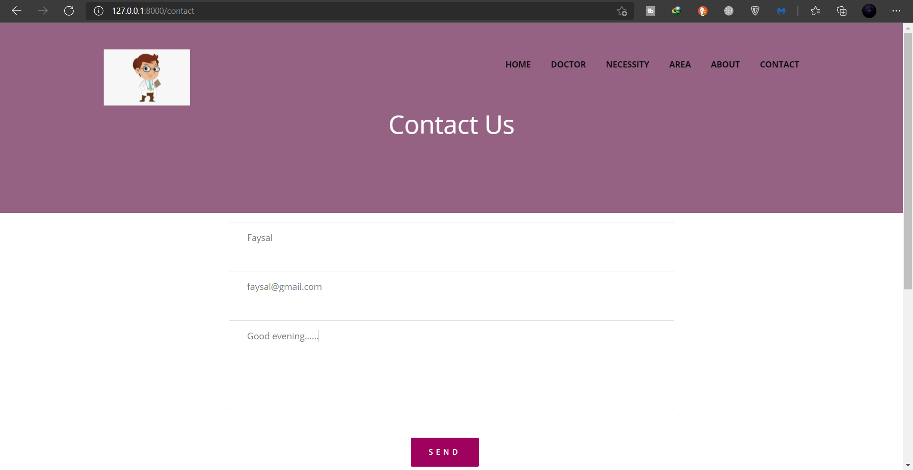
Contact Us

Slide 39
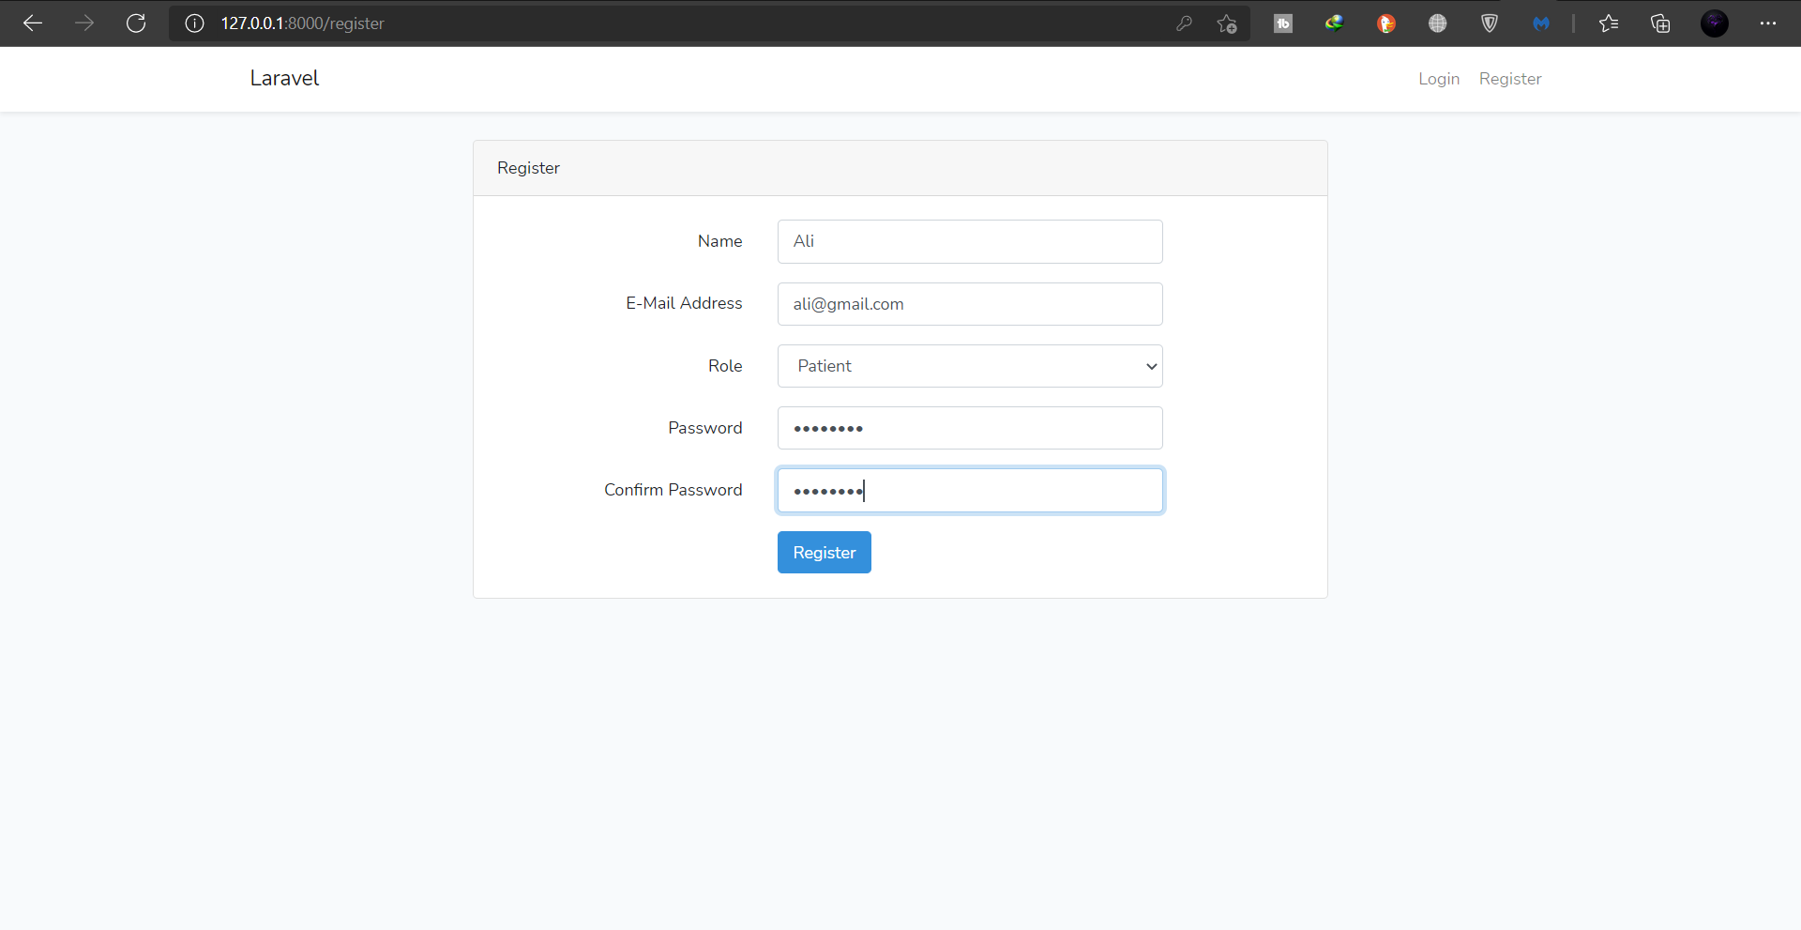
Registration Page

Slide 40
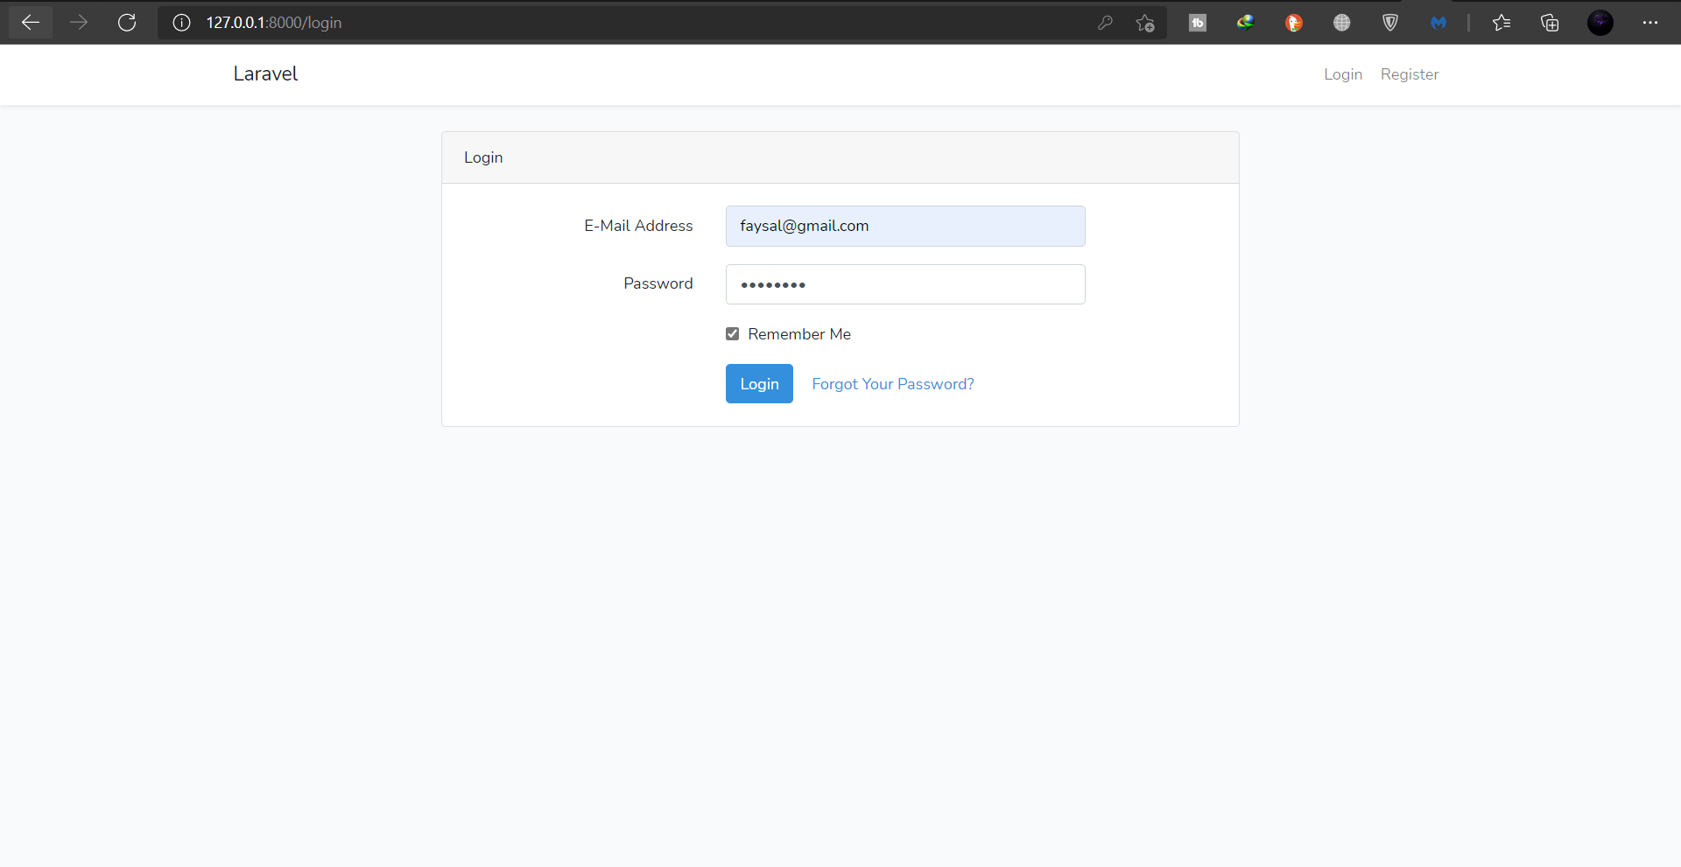
Login Page

Slide 41

Forget Password

Slide 42

Admin Dashboard

Slide 43

Doctor view for Admin

Slide 44

Add Doctor for Admin

Slide 45

Update Doctor for Admin

Slide 46

Delete Doctor for Admin

Slide 47

Patient Necessity view for Admin

Slide 48

Add Patient Necessity for Admin

Slide 49

Update Patient Necessity for Admin

Slide 50

Delete Patient Necessity for Admin

Slide 51

Add Area Guide

Slide 52

View Area Guide for Admin

Slide 53

Delete Area guide

Slide 54

Logout for Admin

Slide 55

Doctor Dashboard

Slide 56

Create Doctor Post for Diagnostic Center

Slide 57

View Doctor Post for Diagnostic Center

Slide 58

Update Doctor Post for Diagnostic Center

Slide 59

Delete Doctor Post for Diagnostic Center

Slide 60

View Patient Necessity Post for Diagnostic Center

Slide 61

Logout for Diagnostic Center

Slide 62

Patient Dashboard

Slide 63

Create Necessity Post for Patient

Slide 64

View Necessity Post for Patient

Slide 65

Update Necessity Post for Patient

Slide 66

Delete Necessity Post for Patient

Slide 67

View Doctor Post for Patient

Slide 68

Logout for Patient

Slide 69
Technology:
HTML & CSS
Laravel framework
Bootstrap
PHP
JavaScript
MySQL Database

Slide 70


Slide 71


